Slide 1
Mid Semester Project Report:
Energize TCNJ
Adriana Barroqueiro, Robert Fenton, Rebecca Goldberg, Alexis Gualario, Robert Helck, Jeffrey Liu, and Vivek Bharadwaj

Slide 2
Overview
To create a comprehensive application that allows the institution to balance environmental concerns with their spending budget and energy costs.
Stage III
went into detail about database model
completed an ER diagram
created a relational schema
Notes:
Alexis
(pretty much read off slide)

Slide 3
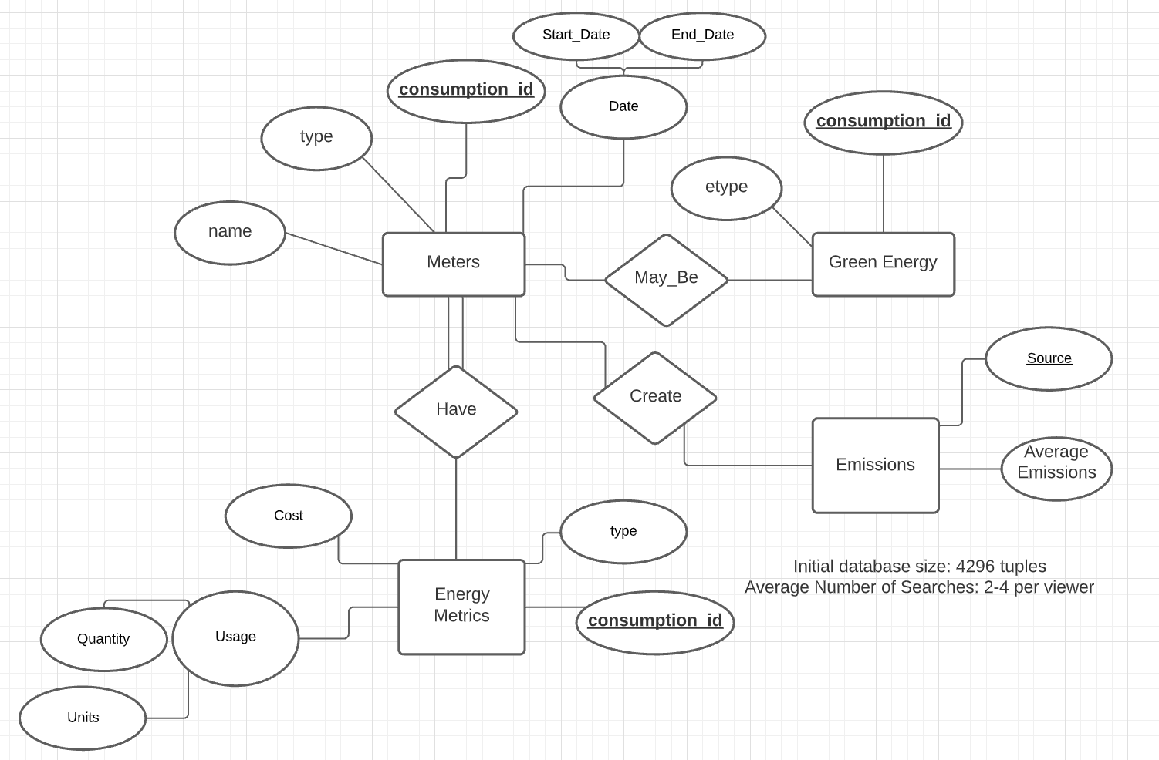
ER Diagram
Notes:
This is the ER diagram we developed for our database. The rectangles represent entities, which are each of the tables that are going to be in the database. The ovals connected to each entity are its attributes, which will be represented as columns in the table. The tables are related to each other with different relationships, seen in the diamonds.
We will be analyzing the consumption, cost, and emissions of the energy. As well as comparing how efficient the green energy options with their cost and reduced emissions.
(Robert Helck)

Slide 4
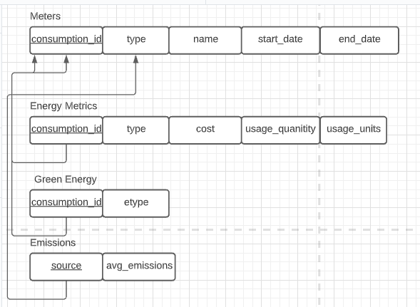
Relational Schema
Notes:
This is our relational schema. It is created from our ER diagram and shows how the various tables in the database will be related to each other.
The energy meter entity is our main table. The energy metrics, green energy, and emissions table are all related to the Meters table, this allows for us to join the data together in various ways to fulfil different queries.
Jeffrey

Slide 5
Supported User Queries
Search for values to find data related within the database
Generate graphical representations for current data or future projections of energy usage, cost, etc.
Provide filters to sort tables by their attributes
Ex. Date -> 2009-10-09 to 2022-03-08
Notes:
The supported user queries in our database will be… (read off slide)
Adriana

Slide 6
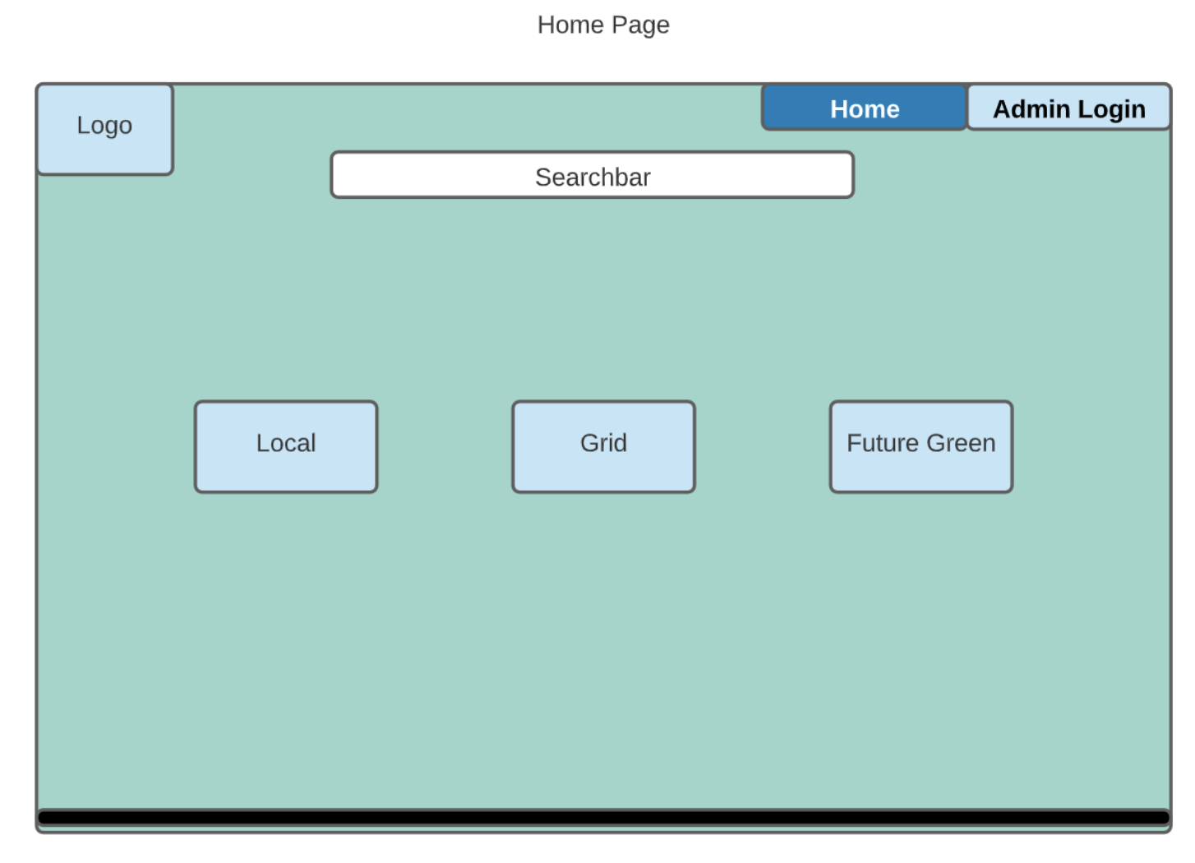
Notes:
This is our initial page from the user side. The user has the option to view the local, grid, and future green tables. There is also a search bar that allows for the user to enter their queries. We would like to include a feature that allows an Admin login which would allow for admins to access and edit the data, while users would only be able to view it.
Rebecca

Slide 7
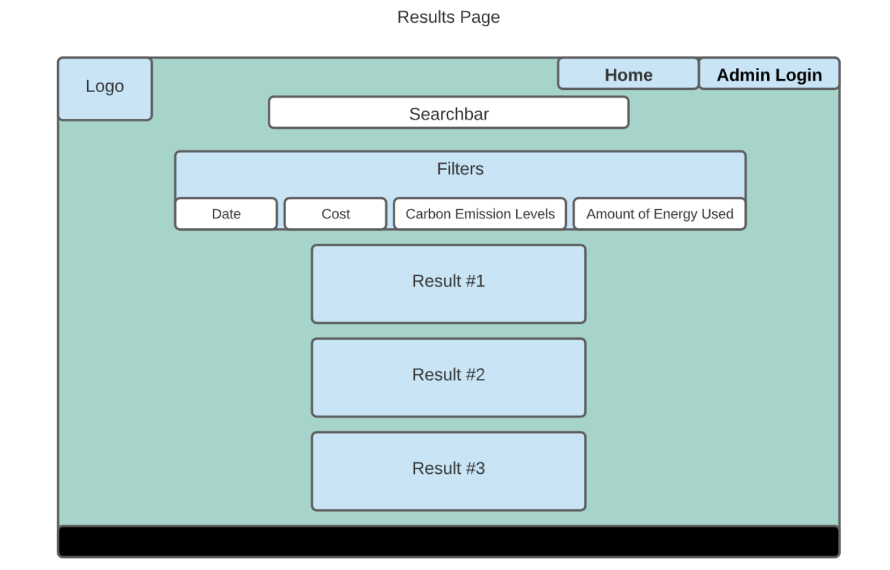
Notes:
When clicking on the search bar, there will be options on how the data can be filtered. The user will be able to sort the data as well as compare it to other data. We would like to add a data visualization feature that would allow some of the Results to be graphs.
Robert F.

Slide 8
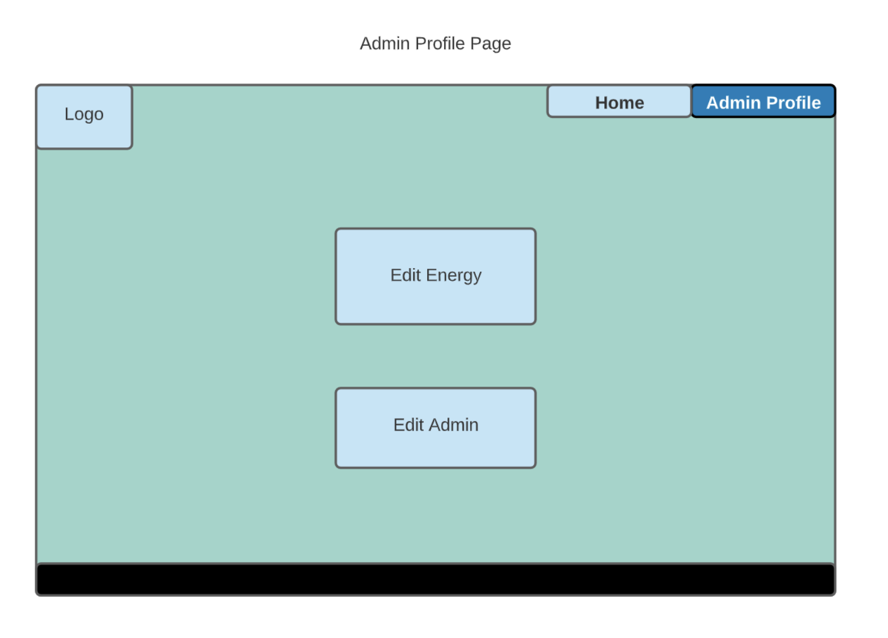
Notes:
This page is the Administrator profile page, the administrator would have the option to edit certain information in order to maintain the database and keep all information up to date. (Vivek)

